Slide 1
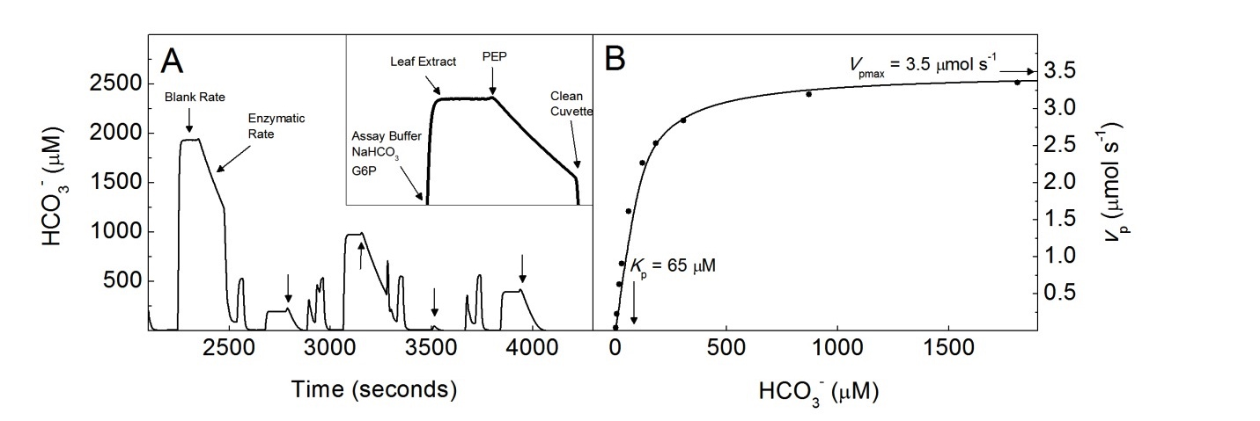
mV to CO₂/O₂ concentrations & rates
V_{max} = 3.5 μmol s⁻¹
CO₂ μM
K_{m} = 65 μM
CO₂ μM
Boyd et al., 2015 Plant Physiology
Notes:
Family
Diversity of Kranz types
Identification of single cells & History

Slide 2
Outline
O₂ calibration
CO₂ calibration in buffer
CO₂ calibration in HCL
HCO₃⁻/ CO₂ ratio
How do we calculate rates of O₂ (v_{o}) and CO₂ (v_{c}) consumption?
How do we calculate the concentrations (μM) of O₂ and CO₂ during the assays?
Notes:
So to summarize…

Slide 3
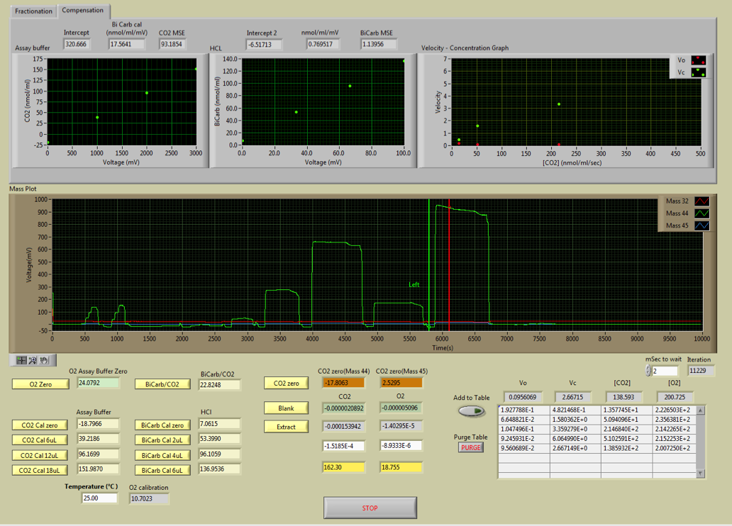
Labview MIMS interface
Notes:
There is a well-supported hypothesis that low atmospheric CO2, high temperatures, and aridity which leads to high rates of photorespiration provided strong selective pressures for the evolution of C₄ photosynthesis, which uses a spatial separated carbon concentrating mechanisms to supply high concentrations of CO2 to Rubisco.

Slide 4
Labview MIMS interface
Notes:
There is a well-supported hypothesis that low atmospheric CO2, high temperatures, and aridity which leads to high rates of photorespiration provided strong selective pressures for the evolution of C₄ photosynthesis, which uses a spatial separated carbon concentrating mechanisms to supply high concentrations of CO2 to Rubisco.

Slide 5
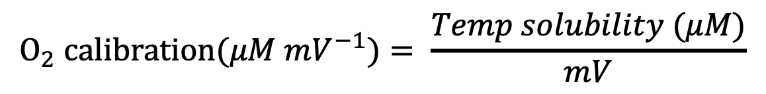
Calibrations: O₂ (m/z 32)
Two-component calibration
Temperature dependent solubility (μM)
mV value for water equilibrated with air
Temp solubility (μM) = =-0.0018*TºC^3 + 0.2229* TºC ^2 -12.387* TºC + 456.49
$$O_{2} calibration(μM {mV}^{−1})= \frac{Temp solubility (μM)}{mV}$$
Notes:
So to summarize…

Slide 6
Calibrations: CO₂ (m/z 44 & 45)
Two-component calibration: total CO₂ & total inorganic carbon
Total CO₂ (μM mV⁻¹)
Notes:
So to summarize…

Slide 7
Labview MIMS interface
Notes:
There is a well-supported hypothesis that low atmospheric CO2, high temperatures, and aridity which leads to high rates of photorespiration provided strong selective pressures for the evolution of C₄ photosynthesis, which uses a spatial separated carbon concentrating mechanisms to supply high concentrations of CO2 to Rubisco.

Slide 8
Calibrations: CO₂ (m/z 44 & 45)
Two-component calibration: total CO₂ & total inorganic carbon
Total CO₂ (μM mV⁻¹)
600 μL of 1N HCL
Three injections of 2 μL 10mM NaHCO₃
Notes:
So to summarize…

Slide 9
Calibrations: CO₂ (m/z 44 & 45)
Two-component calibration: total CO₂ & total inorganic carbon
Total CO₂ (μM mV⁻¹)
values | mV MIMS | μL 10mM NaHCO3 | final conc (μM)
Cal Zero | 7.0615 | 0 | 0
Cal 1 | 53.399 | 2 | 33.3
Cal 2 | 96.1059 | 4 | 66.6
Cal 3 | 136.9536 | 6 | 99.9
Notes:
So to summarize…

Slide 10
Labview MIMS interface
Notes:
There is a well-supported hypothesis that low atmospheric CO2, high temperatures, and aridity which leads to high rates of photorespiration provided strong selective pressures for the evolution of C₄ photosynthesis, which uses a spatial separated carbon concentrating mechanisms to supply high concentrations of CO2 to Rubisco.

Slide 11
Labview MIMS interface
Notes:
There is a well-supported hypothesis that low atmospheric CO2, high temperatures, and aridity which leads to high rates of photorespiration provided strong selective pressures for the evolution of C₄ photosynthesis, which uses a spatial separated carbon concentrating mechanisms to supply high concentrations of CO2 to Rubisco.

Slide 12
Calibrations: CO₂ (m/z 44 & 45)
Two-component calibration: total CO₂ & total inorganic carbon
Total inorganic C (μM total C mV⁻¹)
600 μL of pH 7.6 buffer
Three injections of 6 μL 100mM NaHCO₃
Notes:
So to summarize…

Slide 13
Calibrations: CO₂ (m/z 44 & 45)
Two-component calibration: total CO₂ & total inorganic carbon
Total inorganic C (μM total C mV⁻¹)
values | mV MIMS | vol of 10mM NaHCO3 | final conc (μM)
Cal buffer zero | 29.6769 | 0 | 0
Cal buffer 1 | 97.4796 | 6 | 1000
Cal buffer 2 | 164.2019 | 12 | 2000
Cal buffer 3 | 230.2051 | 18 | 3000
Notes:
So to summarize…

Slide 14
Labview MIMS interface
Notes:
There is a well-supported hypothesis that low atmospheric CO2, high temperatures, and aridity which leads to high rates of photorespiration provided strong selective pressures for the evolution of C₄ photosynthesis, which uses a spatial separated carbon concentrating mechanisms to supply high concentrations of CO2 to Rubisco.

Slide 15
Labview MIMS interface
Notes:
There is a well-supported hypothesis that low atmospheric CO2, high temperatures, and aridity which leads to high rates of photorespiration provided strong selective pressures for the evolution of C₄ photosynthesis, which uses a spatial separated carbon concentrating mechanisms to supply high concentrations of CO2 to Rubisco.

Slide 16
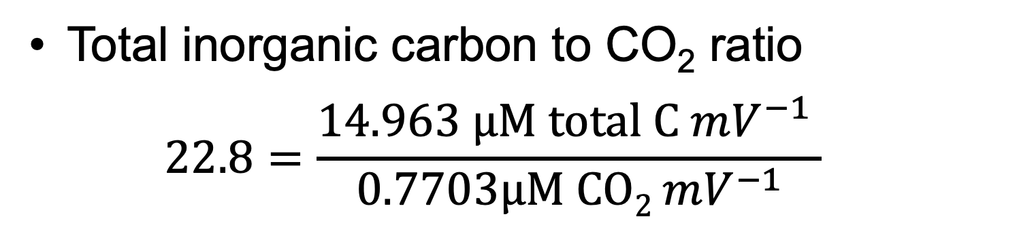
Calibrations: CO₂ (m/z 44 & 45)
Total inorganic carbon to CO₂ ratio
$$22.8=\frac{\text{14.963 }μ\text{M} \text{total} \text{C} {mV}^{−1} }{\text{0.7703}μ\text{M} \text{CO}\text{2}{ mV}^{−1}}$$
Notes:
So to summarize…

Slide 17
Calibrations: CO₂ (m/z 44 & 45)
pH and the HCO₃⁻ to CO₂ ratio
Notes:
So to summarize…

Slide 18
Summary
O₂ calibration ✓
CO₂ calibration in buffer ✓
CO₂ calibration in HCL ✓
HCO₃⁻/ CO₂ ratio ✓
How do we calculate rates of O₂ (v_{o}) and CO₂ (v_{c}) consumption?
How do we calculate the concentrations (μM) of O₂ and CO₂ during the assays?
Notes:
So to summarize…

Slide 19
mV to CO₂/O₂ concentrations & rates
V_{max} = 3.5 μmol s⁻¹
CO₂ μM
K_{m} = 65 μM
CO₂ μM
Boyd et al., 2015 Plant Physiology
Notes:
Family
Diversity of Kranz types
Identification of single cells & History

Slide 20
Labview MIMS interface
Notes:
There is a well-supported hypothesis that low atmospheric CO2, high temperatures, and aridity which leads to high rates of photorespiration provided strong selective pressures for the evolution of C₄ photosynthesis, which uses a spatial separated carbon concentrating mechanisms to supply high concentrations of CO2 to Rubisco.

Slide 21
Labview MIMS interface
CO₂ levels (mV 44 and 45)
Notes:
There is a well-supported hypothesis that low atmospheric CO2, high temperatures, and aridity which leads to high rates of photorespiration provided strong selective pressures for the evolution of C₄ photosynthesis, which uses a spatial separated carbon concentrating mechanisms to supply high concentrations of CO2 to Rubisco.

Slide 22
Labview MIMS interface
CO₂ and O₂ slopes (mV S⁻¹)
Notes:
There is a well-supported hypothesis that low atmospheric CO2, high temperatures, and aridity which leads to high rates of photorespiration provided strong selective pressures for the evolution of C₄ photosynthesis, which uses a spatial separated carbon concentrating mechanisms to supply high concentrations of CO2 to Rubisco.

Slide 23
Labview MIMS interface
CO₂ and O₂ slopes (mV S⁻¹)
Notes:
There is a well-supported hypothesis that low atmospheric CO2, high temperatures, and aridity which leads to high rates of photorespiration provided strong selective pressures for the evolution of C₄ photosynthesis, which uses a spatial separated carbon concentrating mechanisms to supply high concentrations of CO2 to Rubisco.

Slide 24
Labview MIMS interface
Net rate of CO₂ and O₂ consumption (mV S⁻¹)=
Extract - Blank
Notes:
There is a well-supported hypothesis that low atmospheric CO2, high temperatures, and aridity which leads to high rates of photorespiration provided strong selective pressures for the evolution of C₄ photosynthesis, which uses a spatial separated carbon concentrating mechanisms to supply high concentrations of CO2 to Rubisco.

Slide 25
Labview MIMS interface
CO₂ and O₂ levels (mV)
Notes:
There is a well-supported hypothesis that low atmospheric CO2, high temperatures, and aridity which leads to high rates of photorespiration provided strong selective pressures for the evolution of C₄ photosynthesis, which uses a spatial separated carbon concentrating mechanisms to supply high concentrations of CO2 to Rubisco.

Slide 26
Labview MIMS interface
Notes:
There is a well-supported hypothesis that low atmospheric CO2, high temperatures, and aridity which leads to high rates of photorespiration provided strong selective pressures for the evolution of C₄ photosynthesis, which uses a spatial separated carbon concentrating mechanisms to supply high concentrations of CO2 to Rubisco.

Slide 27
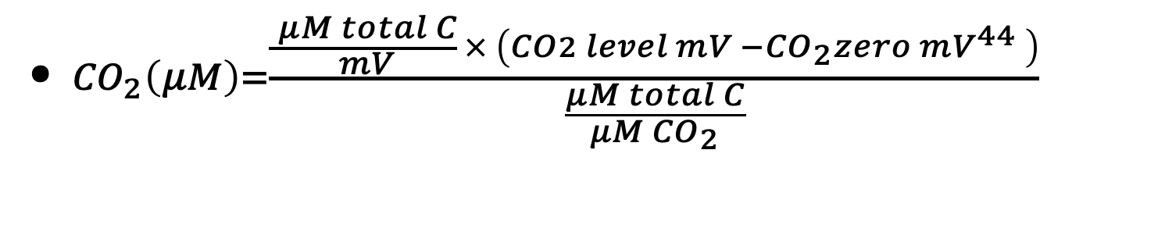
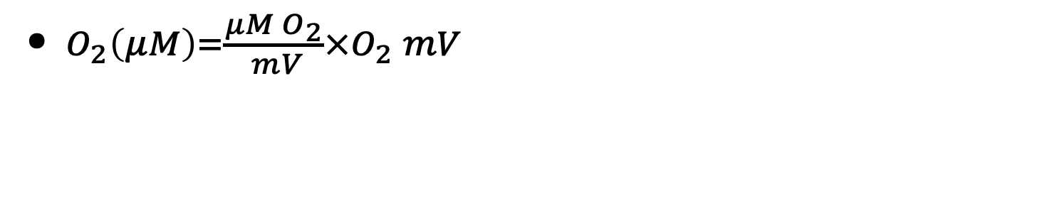
Calculating CO₂ and O₂ concentrations
Buffer calibration with 100mM NaHCO₃
MIMS reading 44m/z
MIMS reading 44m/z w/o CO2
${CO}_{2}\left(μM\right)=\frac{\frac{ μM total C}{ mV} × \left(CO2 level mV −{CO}_{2}{zero mV}^{44} \right)}{\frac{μM total C}{μM{ CO}_{2}}}$
Total C/CO₂ ratio
$O_{2}\left(μM\right)=\frac{{μM O}_{2}}{ mV}×O_{2} mV$
O₂ calibration = temp solubility/water equilibrated with air
MIMS reading 32m/z
Notes:
So to summarize…

Slide 28
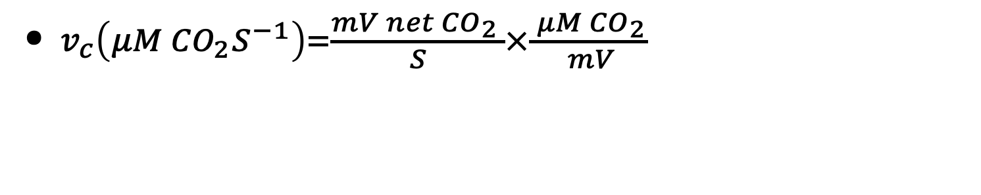
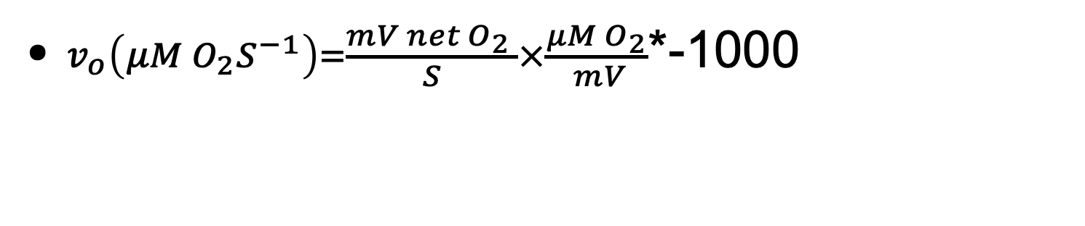
Calculating CO₂ and O₂ concentrations
$v_{c}\left(μM {CO}_{2}S^{−1}\right)=\frac{mV net{ CO}_{2} }{S}×\frac{ μM {CO}_{2}}{ mV}$
Net rate of CO₂ consumption
Buffer calibration with 100mM NaHCO₃
$v_{o}\left(μM O_{2}S^{−1}\right)=\frac{mV net{ O}_{2} }{S}×\frac{{μM O}_{2}}{ mV}$*-1000
Net rate of O₂ consumption
O₂ calibration = temp solubility/water equilibrated with air
Notes:
So to summarize…

Slide 29
Summary
O₂ calibration ✓
CO₂ calibration in buffer ✓
CO₂ calibration in HCL ✓
HCO₃⁻/ CO₂ ratio ✓
How do we calculate rates of O₂ (v_{o}) and CO₂ (v_{c}) consumption? ✓
How do we calculate the concentrations (μM) of O₂ and CO₂ during the assays? ✓
Notes:
So to summarize…

